Slide 1
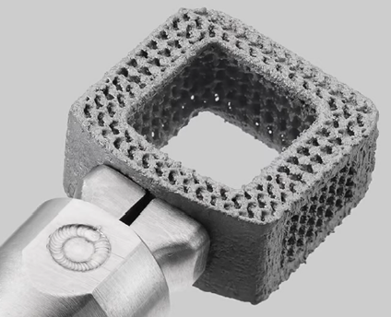
3D Printing Material: Ti (Titanium)
3D Print Ti
Titanium is King in Metal 3D Printing. 3D printed Ti is prized for its low “buy-to-fly” ratio, an aerospace term that refers to the correlation between the weight of the initial material and the printed weight.
Titanium and titanium-based alloys offer high mechanical strength, high strength-to-weight ratio, and better corrosion resistance than stainless steels.
In the medical industry, 3D printed titanium implants have been successful across spine, hip, and knee.
Now, with 3D printing, it is possible to produce implants designed exclusively for individual patients.

Slide 2
3D Printing Material: Ti (Titanium)
Advantages of 3D Printing Ti
Casting and machining titanium correlates more production costs because higher material waste, moulding and tooling acquisitions, and higher energy consumption.
3D printing Ti enables efficient manufacturing with lower consumption of raw material and lower waste.
Furthermore, 3D printing Ti also enables complex designs, such as internal channels and lattice in fills to reduce weight.
Moreover, Titanium is also biocompatible and resists corrosion.

Slide 3
3D Printing Material: Ti (Titanium)
Disadvantages:
Titanium 3D printing is expensive.

Slide 4
3D Printing Material: Ti (Titanium)
Types of Titanium for Additive Manufacturing
Titanium 6Al-4V, grade 5 is the most commonly used in titanium alloy in additive manufacturing and is ideal for prototypes and functional parts in the aerospace and automotive fields.
Titanium 6Al-4V, grade 23 is a biocompatible alloy is commonly used for medical implants and prostheses.
Titanium Beta 21S has one of the lowest hydrogen uptake efficiency levelsof any titanium alloy. It an ideal candidate for orthopaedic implants and aerospace engine applications.
Cp-Ti (Pure Titanium), grade 1, 2 are extensively used in the medical field for a wide range of applications, due to the biocompatibility of titanium with the human body.
TA15 is a near-alpha titanium-alloy with additives of aluminium and zirconium.

Slide 5
3D Printing Material: Ti (Titanium)
How to 3D Print Titanium?
Several methods are using as follows:
Laser powder bed fusion (LPBF).
Direct energy deposition (DED).
Rapid plasma deposition (RPD)

Slide 6
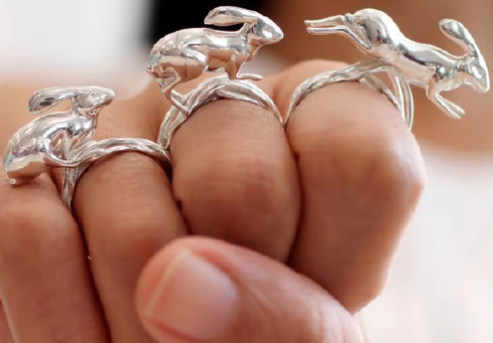
3D Printing Material: Ag (Silver) and Gold (Au)
3D Print Ag
The precious metal like Au, and Ag is often used to make jewellery, which could always need complex shapes and designs.
Hence, 3D printing silver and gold sounds wonderful.
The 3D printing of both silver, and gold can be done by using several process, both at home or through a professional printing service. Methods are;
1.Deposition Printing.
2. Direct Metal Laser Sintering (DMLS).
3. Lost-Wax Casting / Lost-PLA Casting.

Slide 7
3D Printing Material: Ag (Silver) and Gold (Au)
1.Deposition Printing:
Currently, there are no methods of directly 3D printing silver using an Fused Deposition Modelling (FDM) 3D printer.
The Virtual Foundry offering several metal-infused filaments to print from, but silver currently isn’t one of them.
Positively, the indirect methods of using FDM printing to create silver objects, such as lost-wax and lost-PLA casting.

Slide 8
3D Printing Material: Ag (Silver) and Gold (Au)
Direct Metal Laser Sintering (DMLS)
The DMLS 3D printing process uses lasers to fuse metal powder together layer by layer to make a fully metal part. The process involve as follows;
The 3D printable part is designed in a 3D modelling software.
Then, layer of powder is first flattened over the printable area.
The laser beam selectively sinters the object’s first layer in the bed of powder.
The process repeats itself with a new layer of powder being spread on top of the previous layer, which is again selectively sintered.
The final part is removed from the powder and a cleaning process is performed before the part is put into use.

Slide 9
3D Printing Material: Ag (Silver) and Gold (Au)
Lost-Wax Casting/ Lost-PLA Casting:
Lost-wax casting process is used to create a wax mould of an object to cast a metal version of the object.
Whereas, Lost-PLA casting is nearly the same process as lost-wax casting only exception, PLA is used in place of wax.
Design an object in 3D modelling software.
Use the PLA object to create a plaster mould.
Once the plaster mould has dried, put the mould into a kiln to burn out the PLA material and leave a void.
Once the PLA has been removed, pour liquid metal into the mould to create your silver object.
Once the object and mould have cooled, you can remove the plaster and cut away the sprues, sanding and polishing the object for use.
Once this process is done, you should have a silver part with the same properties as raw silver would have.

Slide 10
3D Printing Material: Ag (Silver) and Gold (Au)
Distinct Characteristics:
It has high electrical conductance.
It is heat proof.
Disadvantages:
Printing with gold and silver are expensive.
It takes a lot of effort and time to get it right.
Both gold and silver are difficult to work with lasers because of its high reflectivity and high thermal conductivity.
Since extremely high temperature is needed to print these materials, a regular FDM 3D printer is not suitable to use.

